Slide 1




Are Action movies more successful for Disney?

Slide 2
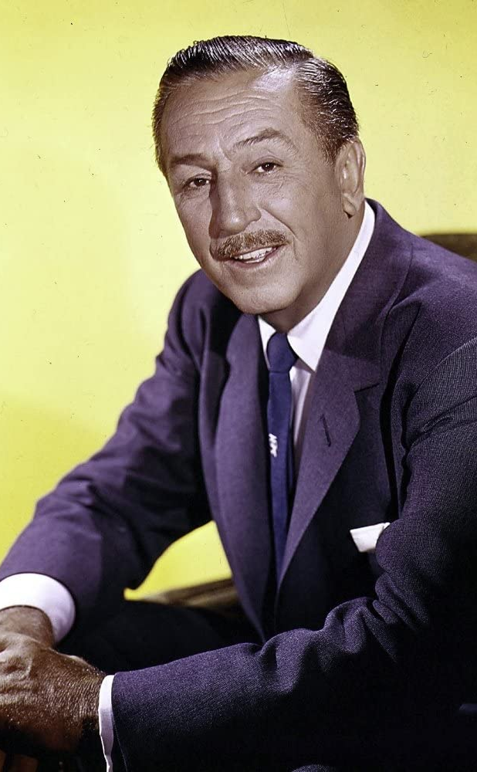
INTRODUCTION
Our project aims to understand whether ‘Genre’ plays a vital role in the success of a movie. For this experiment, we use the movie’s gross revenue as the proxy to decide the measure of success of a movie. We control for different variables like budget, year of release, star presence, IMDB rating and see how they affect success.
4 Variables
1 Outcome

Slide 3
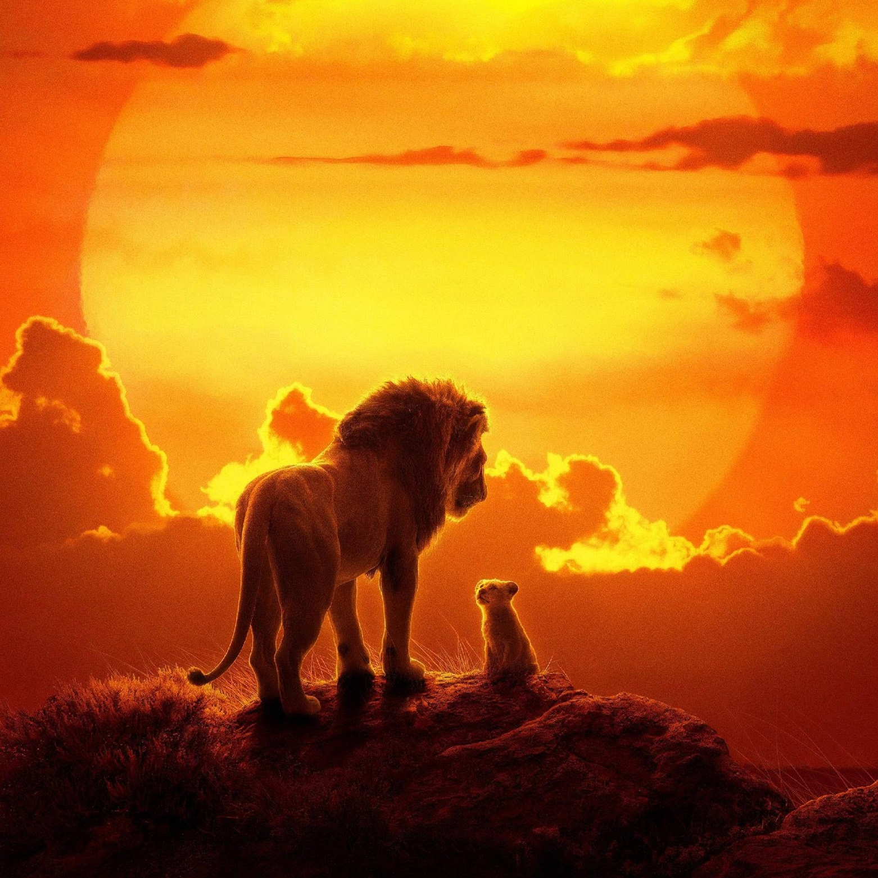
IDEAL EXPERIMENT
The ideal experiment here would consist of two groups; Action movies and Non-Action movies. The other variables like the release date, budget, movie stars, IMDB score, movie runtime remain the same. This way, we can attribute the success of the film to only “Genre”.

Slide 4




PROCESS
Conclusion
Linear Regression
Hypothesis
Data Collection & Structuring

Slide 5




INDEPENDENT VARIABLES
Budget
Star Rating
IMDB score
Genre

Slide 6


DATA SOURCES
Kaggle
Data Camp

Slide 7
HYPOTHESIS
Null Hypothesis
Alternate
Hypothesis
Action movies are as successful for Disney - there is no difference
Action movies are more successful for Disney

Slide 8
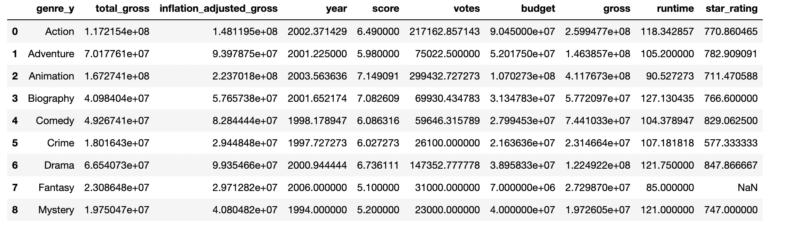
Summary Statistics

Slide 9
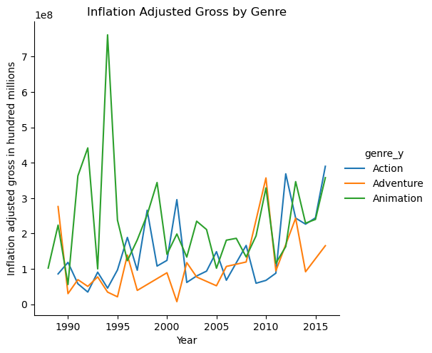
We see a large jump in Action movies from 2010 - 2012, and this could be attributed to the release of the movie the Avengers in 2012 which grossed over 600 million dollars.
The massive increase in gross for animation movies in 1994 is because of the film Lion King which grossed around 760 million.

Slide 10
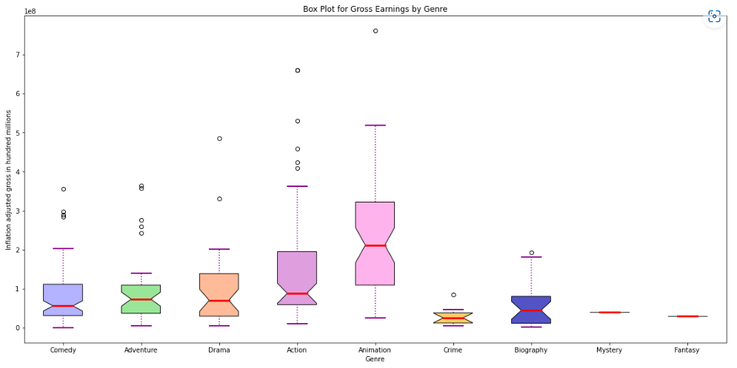

Slide 11
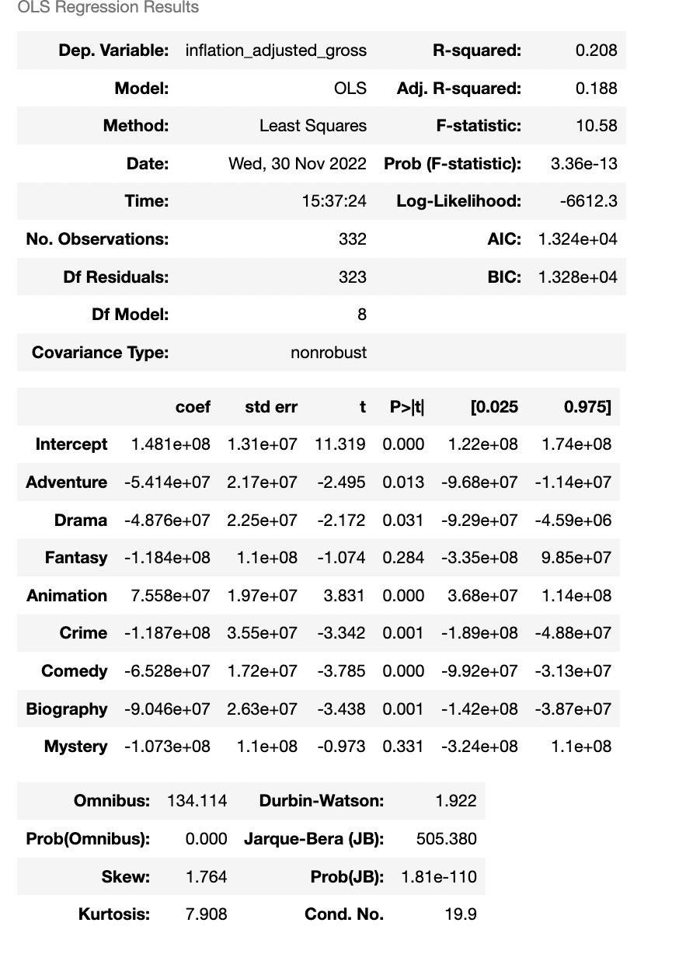
Here we use the inflation adjusted gross as the dependent variable, and the independent variables are all the genres apart from action.
The intercept value is the average that Action movies gross, and all the coefficient values indicate the difference between that genre and action. Seeing that these values are negative (apart from animation), we can conclude that Action movies gross second the highest on average, following Animation movies.
We see that the R^2 value of this model is low, we can see that genre alone is not an adequate predictor of inflation adjusted gross, and other variables may have an effect. We explore these as we go ahead.

Slide 12
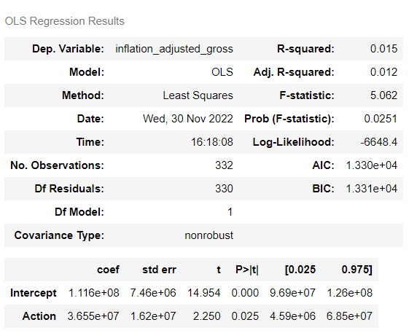
Here we use the inflation adjusted gross as the dependent variable, and the independent variable is Action genre
If the movie is of Action genre, then it earns 36 million higher than non Action movies. This result is significant because of the low p-value (0.025)
We see that the R^2 value of this model is low, we can see that Action genre alone is not an adequate predictor of inflation adjusted gross, and other variables have an effect. We explore these as we go ahead.

Slide 13
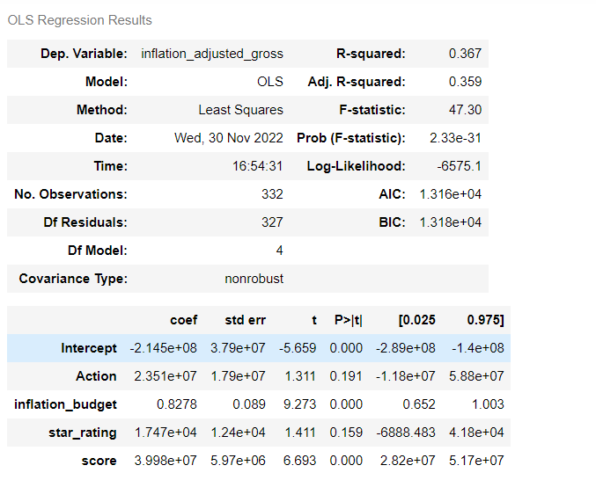
Here we use the inflation adjusted gross as the dependent variable, and the independent variables are Action genre, inflation adjusted budget, star rating, IMDB score.
Controlling for inflation adjusted budget, star rating and IMDB score, an Action movie earns 23 million more than non-Action movie. However, the p value is high which makes this conclusion insignificant.

Slide 14
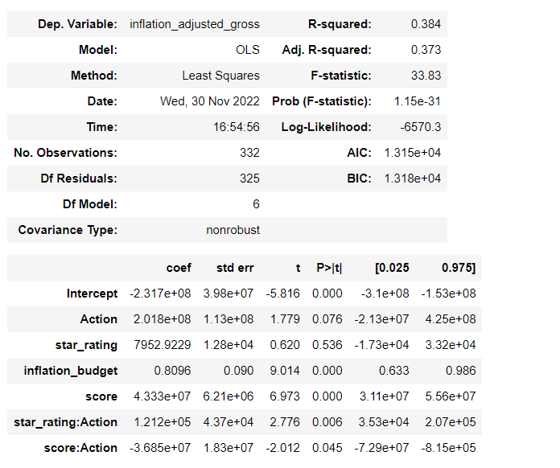
Here we use the inflation adjusted gross as the dependent variable, and the independent variables are Action genre, inflation adjusted budget, star rating, IMDB score, interacted variable (star rating and action), interacted term (IMDB score and action).
The addition of interaction terms improves the significance of Action genre and increases the explainability of variation of inflation adjusted gross revenue

Slide 15
CONCLUSION
Based on all the regressions that we ran we have the following conclusions:
If the genre of the movie is action and we don't take into account any other factor, the action genre highly impacts the inflation adjusted gross. An Action movie is expected to earn $36 million more than non Action movies.
If we take into account other factors that impact the gross earnings of a movie, the action genre alone is not that significant, but the IMDB rating and the budget of the movie become important factors.
Including all genres in the model we could see that when compared with action movies all other genres except animation garnered lower average gross income

Slide 16
THANKS !

